Slide 1
2015 University Bike Share Survey
Prepared from:
Grace Kyung
Property of: University of Illinois Urbana-Champaign
Institute of Sustainability, Energy, and Environment

Slide 2
Contents
Introduction
Survey Analysis
Conclusion

Slide 3
Introduction

Slide 4
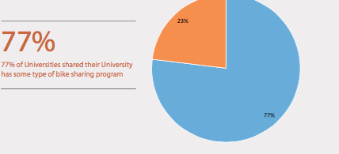
Introduction
38 Questions
41 Respondents

Slide 5
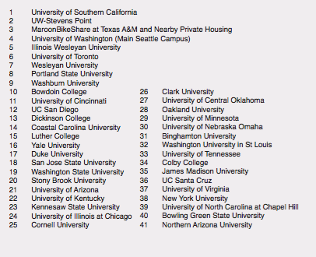
University Respondents

Slide 6
Survey Analysis

Slide 7
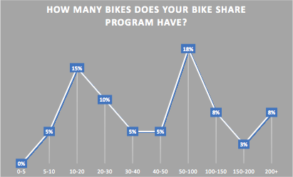
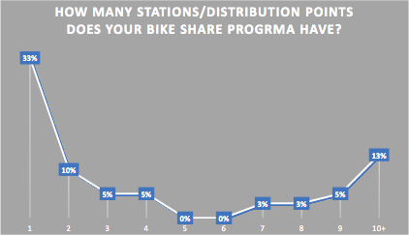

Slide 8
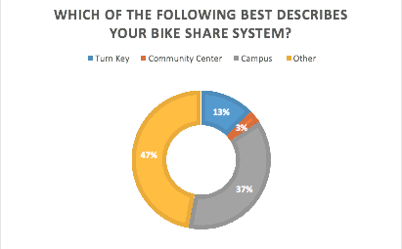

Slide 9
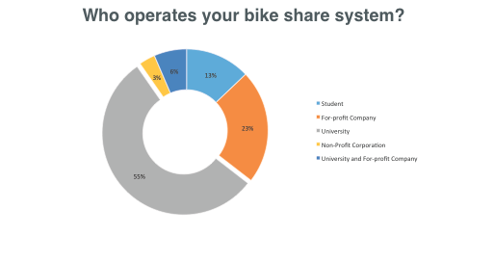
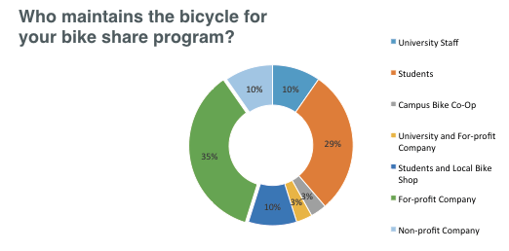

Slide 11
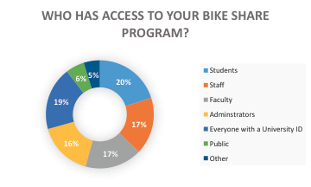

Slide 12
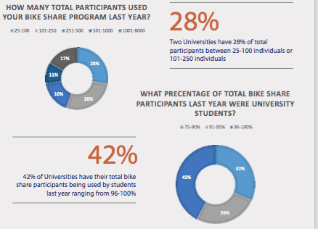

Slide 13
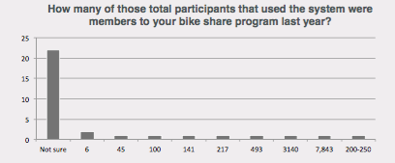
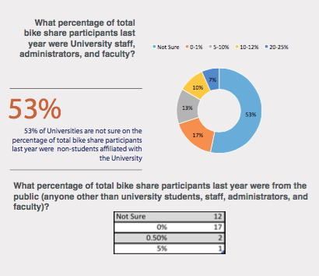

Slide 14
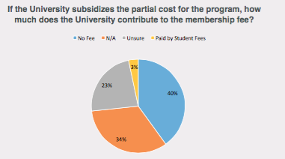
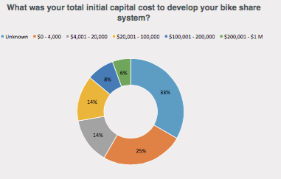

Slide 15
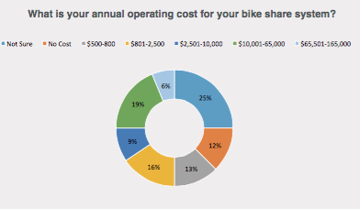

Slide 16
Thank you!

